Slide 1
Health record system
NAME : URVAL SHAH
ROLL NO : 130
ENROLL.NO : 22002170110170
BATCH : DIV 5
BRANCH : CE

Slide 2
Agenda
To manage data and to store data in tabular form.
To keep data of health details and user details health record system database is created.

Slide 3
INTRODUCTION
It is a database containing specific tables of user_details,calculated_details,diet_plan,diet_schedule,range,wokout_plan.
Each and every table is connected using foreign key.
Table has several data like details of user, bmi, bmr, range, diet, workout.
By query or by plsql block we can calculate some of the details or we can fetch it.

Slide 4
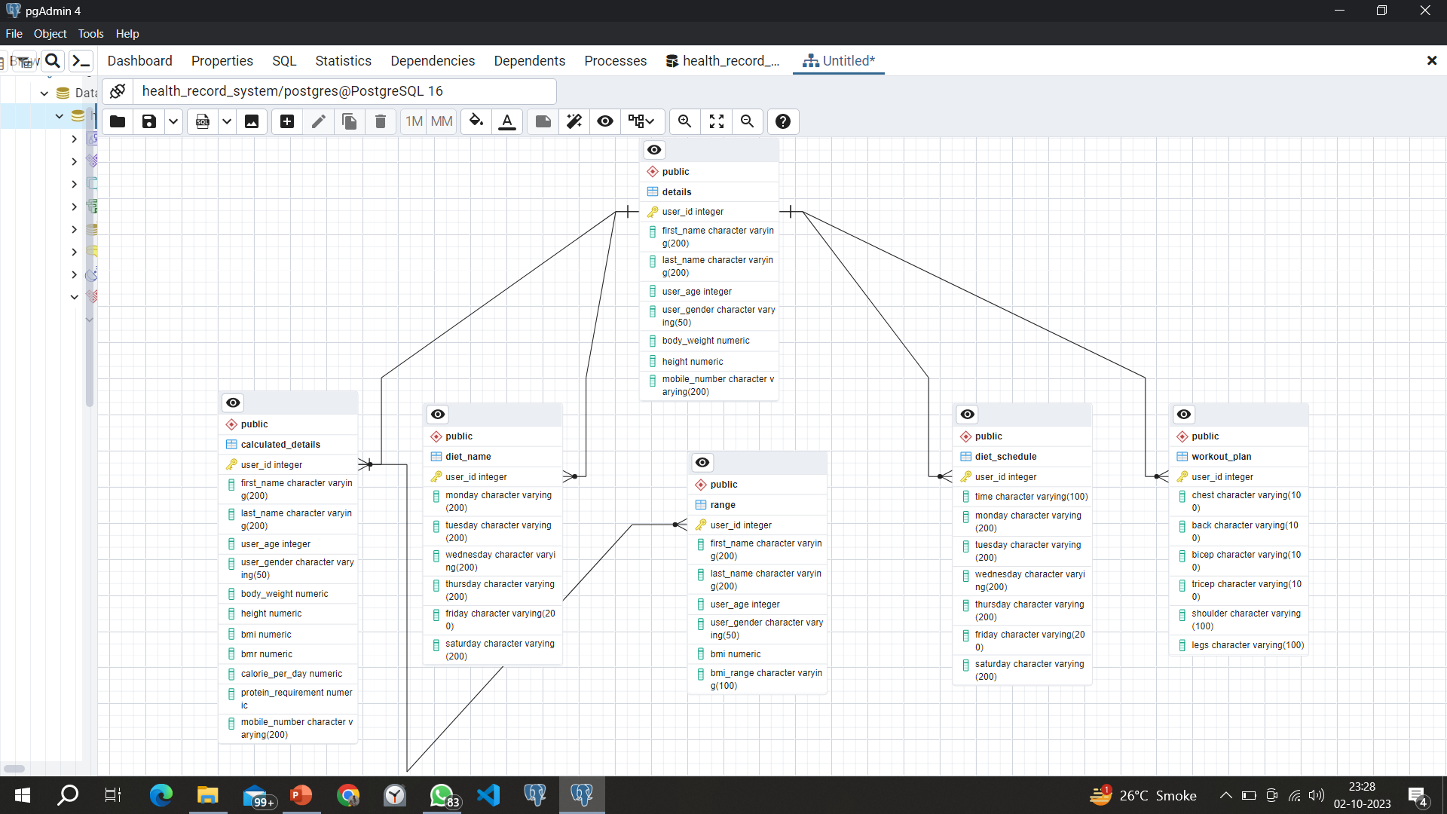
ENTITY RELATIONSHIP DIAGRAM

Slide 5
MERITS AND DEMERITS
Merits
Demerits
Data Integrity and Accuracy
Data Security
Concurrent Access
Data Redundancy Reduction
Data Query and Retrieval
Cost
Limited Flexibility
Complex Query Language
Overhead for Small Projects
Data Migration Complexity

Slide 6
Thank you

